Slide 2

Natural Language Processing
Self-Attention and Transformers
Mamatha.H.R
Department of Computer Science and Engineering

Slide 3

NATURAL LANGUAGE PROCESSING
Disclaimer
These slides are largely prepared from
https://arxiv.org/abs/1706.03762
https://jalammar.github.io/illustrated-transformer/

Slide 4
NATURAL LANGUAGE PROCESSING
Why Attention?
Attention is a concept that helped improve the performance of neural machine translation applications.
The Transformer – a model that uses attention to boost the speed with which these models can be trained and was proposed in the paper “Attention is All You Need”.

Slide 5
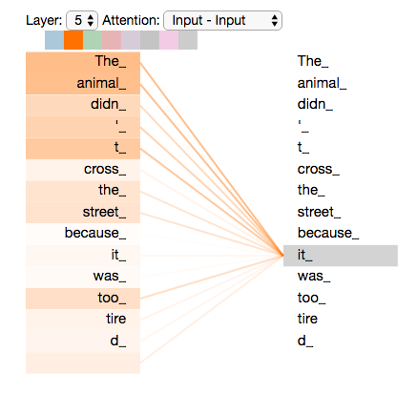
NATURAL LANGUAGE PROCESSING
Why Attention?
Say the following sentence is an input sentence we want to translate:
”The animal didn't cross the street because it was too tired”
What does “it” in this sentence refer to? Is it referring to the street or to the animal? It’s a simple question to a human, but not as simple to an algorithm.
Notes:
When the model is processing the word “it”, self-attention allows it to associate “it” with “animal”.
As the model processes each word (each position in the input sequence), self attention allows it to look at other positions in the input sequence for clues that can help lead to a better encoding for this word.

Slide 6
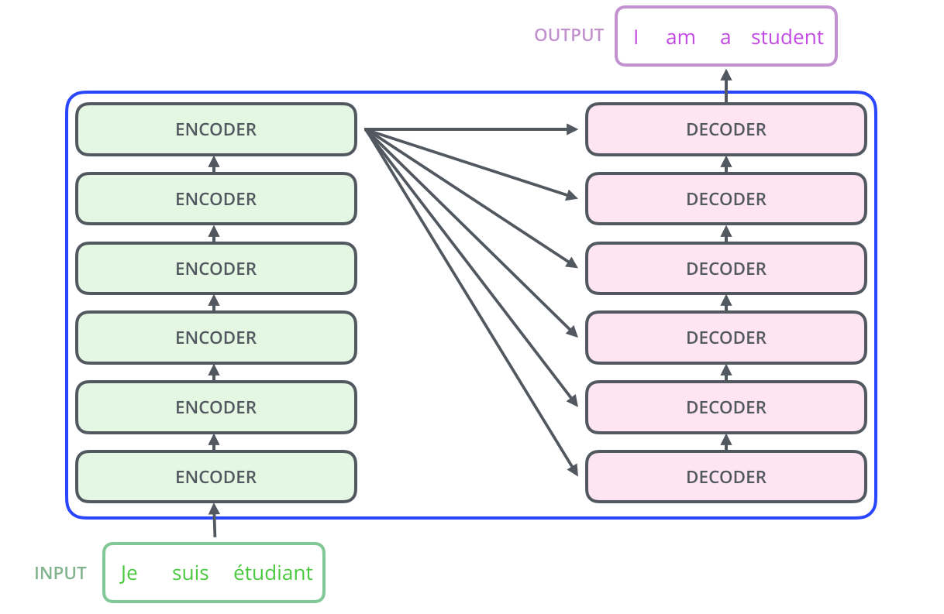
NATURAL LANGUAGE PROCESSING
Attention is All You Need
Let’s begin by looking at the model as a single black box. In a machine translation application, it would take a sentence in one language, and output its translation in another.
The Transformer proposed in the paper stacks six encoders and decoder on top of each other. Let’s see what an encoder and decoder do now.

Slide 7
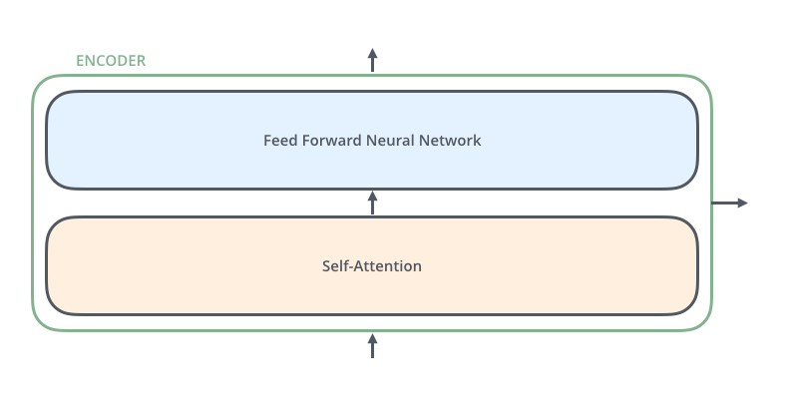
NATURAL LANGUAGE PROCESSING
What is an Encoder?
The encoders are all identical in structure (yet they do not share weights). Each one is broken down into two sub-layers:
The encoder’s inputs first flow through a self-attention layer – a layer that helps the encoder look at other words in the input sentence as it encodes a specific word.
The outputs of the self-attention layer are fed to a feed-forward neural network. The exact same feed-forward network is independently applied to each position

Slide 8
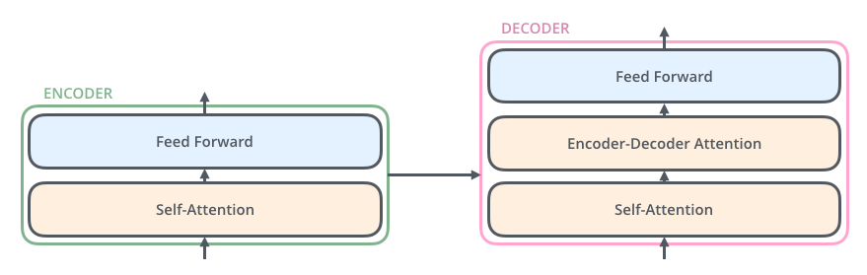
NATURAL LANGUAGE PROCESSING
What is a Decoder?
The decoder has both those layers, but between them is an attention layer that helps the decoder focus on relevant parts of the input sentence

Slide 9
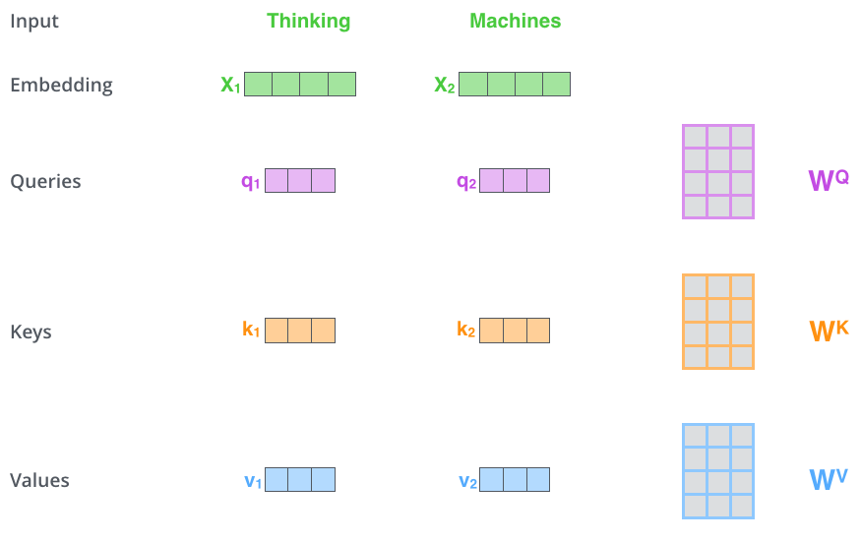
NATURAL LANGUAGE PROCESSING
What is Self-Attention?
Let’s first look at how to calculate self-attention using vectors, then proceed to look at how it’s actually implemented – using matrices.
The first step in calculating self-attention is to create three vectors from each of the encoder’s input vectors (in this case, the embedding of each word). So for each word, we create a Query vector, a Key vector, and a Value vector. These vectors are created by multiplying the embedding by three matrices that we trained during the training process.

Slide 10
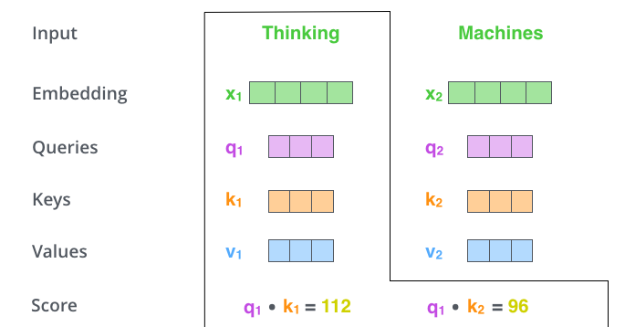
NATURAL LANGUAGE PROCESSING
What is Self-Attention?
The second step in calculating self-attention is to calculate a score. The score is calculated by taking the dot product of the query vector with the key vector of the respective word we’re scoring.

Slide 11
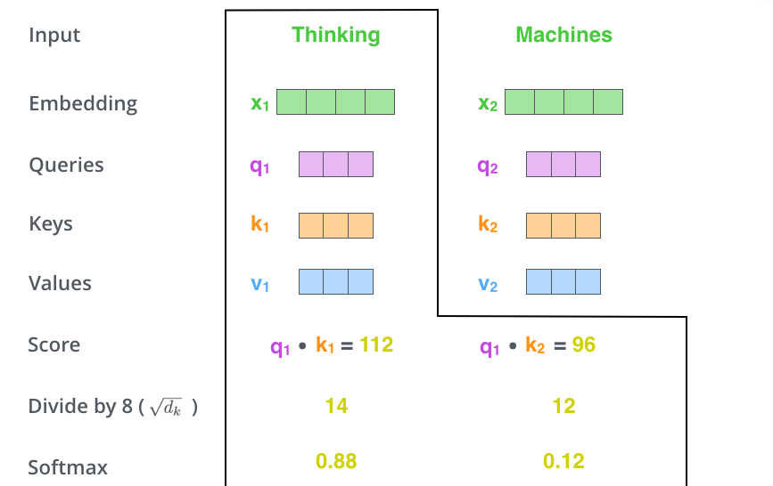
NATURAL LANGUAGE PROCESSING
What is Self-Attention?
The third and fourth steps are to divide the scores by 8 (the square root of the dimension of the key vectors used in the paper – 64. This leads to having more stable gradients)
Then pass the result through a softmax operation. Softmax normalizes the scores so they’re all positive and add up to 1.

Slide 12
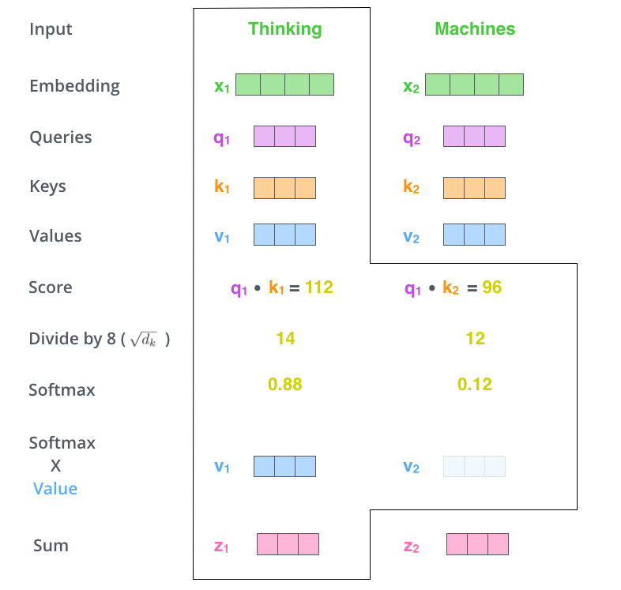
NATURAL LANGUAGE PROCESSING
What is Self-Attention?
The fifth step is to multiply each value vector by the softmax score. The intuition here is to keep intact the values of the word(s) we want to focus on, and drown-out irrelevant words (by multiplying them by tiny numbers like 0.001, for example).
The sixth step is to sum up the weighted value vectors. This produces the output of the self-attention layer at this position (for the first word).

Slide 13
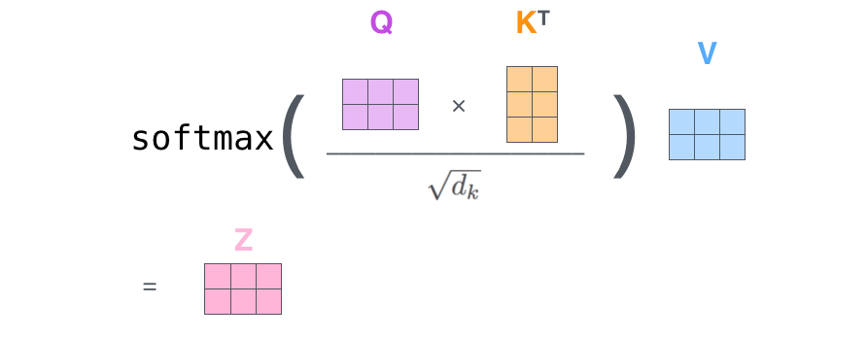
NATURAL LANGUAGE PROCESSING
Matrix calculation for Self-Attention
Each word in a sentence is embedded and packed into a single matrix. Self-Attention can now be applied on the matrix by condensing steps 2 to 6 using the below expression.

Slide 14
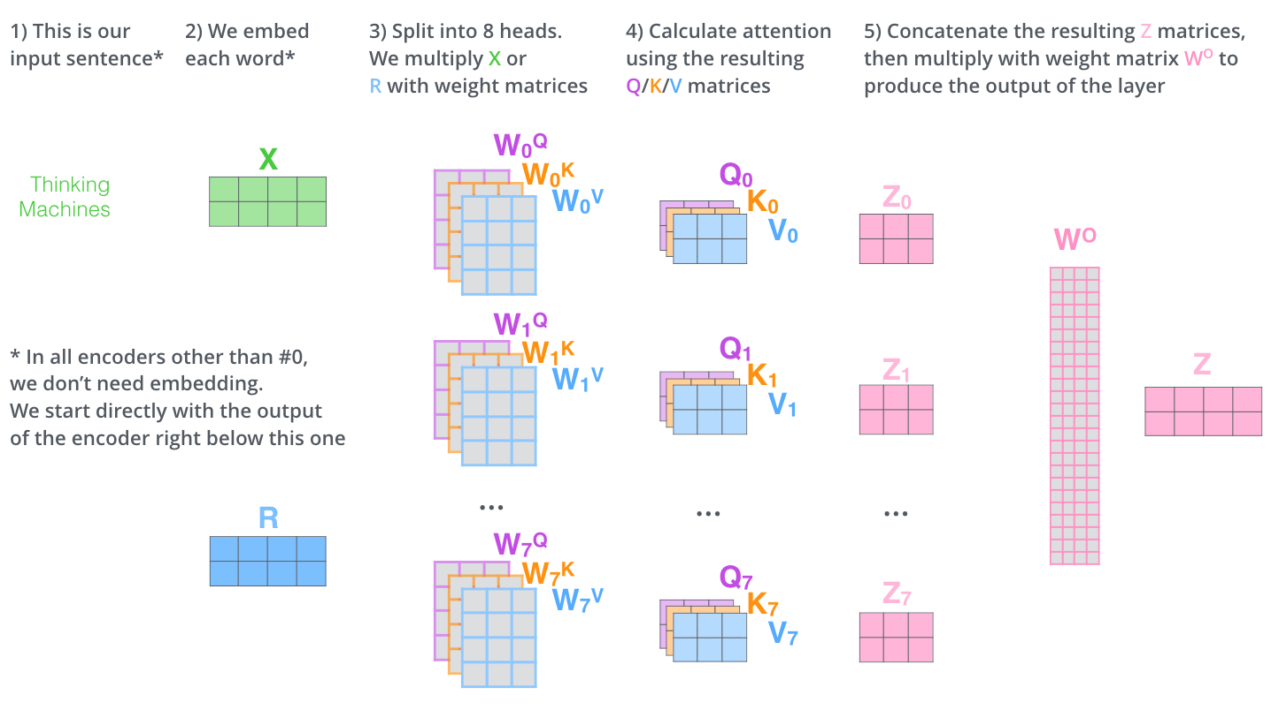
NATURAL LANGUAGE PROCESSING
Multi-Headed Attention
If we do the same self-attention calculation we outlined above, just eight different times with different weight matrices (or Heads) it is called Multi-Headed Attention.

Slide 15
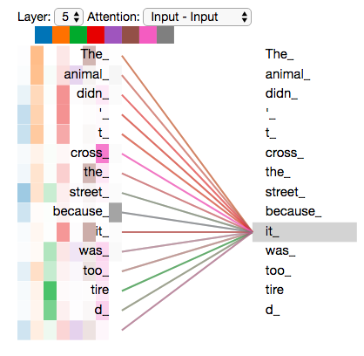
NATURAL LANGUAGE PROCESSING
Transformers - Attention
Now that we have touched upon attention heads, let’s revisit our example from before to see where the different attention heads are focusing as we encode the word “it” in our example sentence.

Slide 16
NATURAL LANGUAGE PROCESSING
Transformers - Positional Encoding
One thing that’s missing from the model as we have described it so far is a way to account for the order of the words in the input sequence.
To address this, the transformer adds a vector to each input embedding. These vectors follow a specific pattern that the model learns, which helps it determine the position of each word, or the distance between different words in the sequence. The intuition here is that adding these values to the embeddings provides meaningful distances between the embedding vectors once they’re projected into Q/K/V vectors and during dot-product attention.

Slide 17
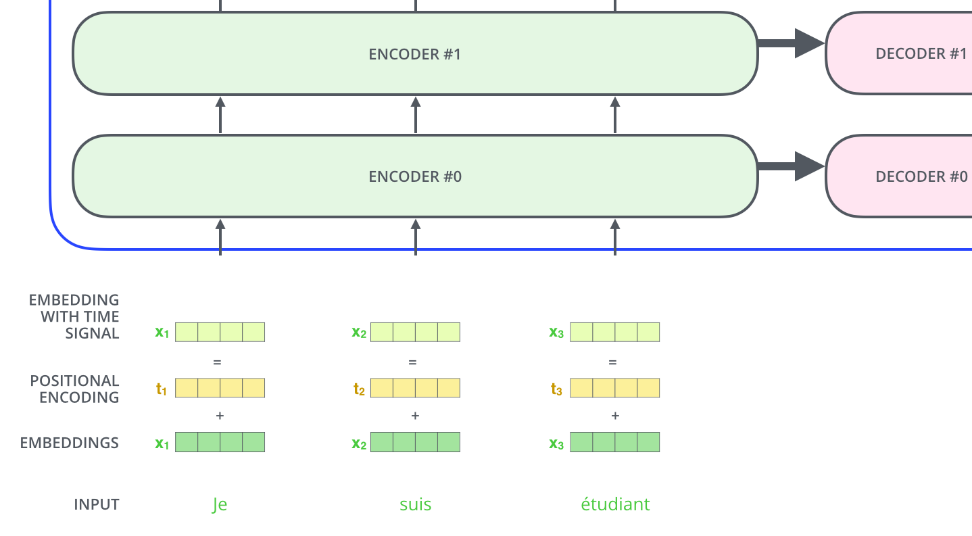
NATURAL LANGUAGE PROCESSING
Transformers - Positional Encodings

Slide 18
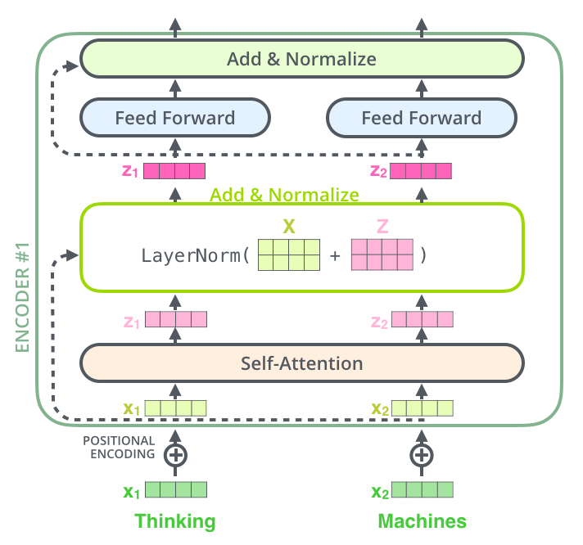
NATURAL LANGUAGE PROCESSING
Transformer - Layer Normalisation
One detail in the architecture of the encoder that we need to mention before moving on, is that each sub-layer, in each encoder has a residual connection around it, and is followed by a layer-normalization step.

Slide 19
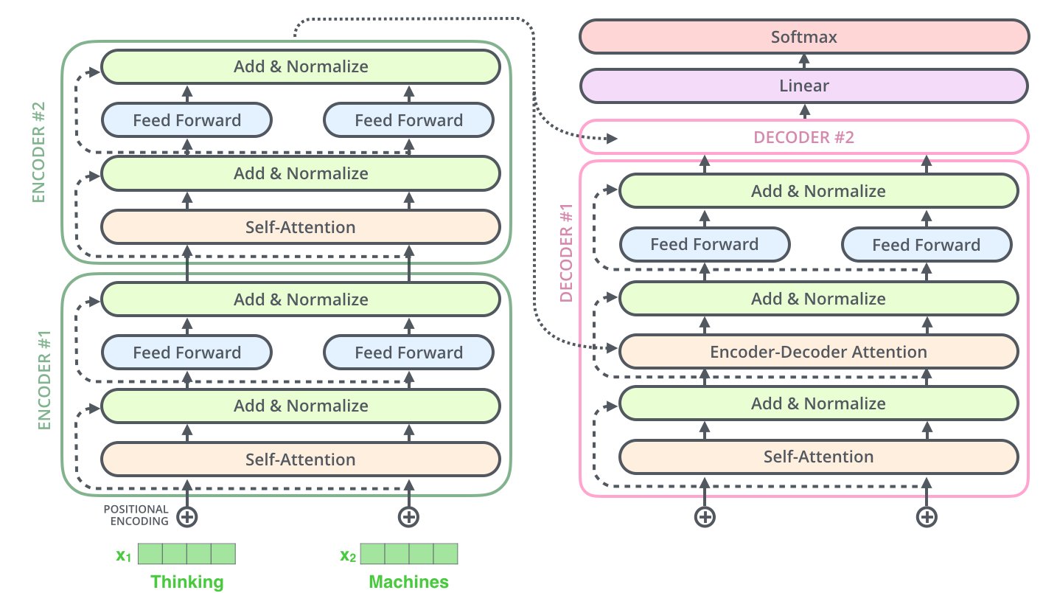
NATURAL LANGUAGE PROCESSING
Transformer - Architecture

Slide 20
NATURAL LANGUAGE PROCESSING
Course References
Text Book:
1. “Introduction to Natural Language Processing”, Jacob Eisenstein, MIT Press, Adaptive computation and Machine Learning series, 18th October, 2019.
The open source softcopy is available at githubhttps://github.com/jacobeisenstein/gt-nlp class/blob/master/notes/eisenstein-nlp-notes.pdf.
Reference Books:
1: “Speech and Natural Language Processing”, Daniel Jurafsky and James H. Martin, 2nd edition paperback,2013.
The more up to date 3rd edition draft is available at http://web.stanford.edu/~jurafsky/slp3/

